Slide 1
Evergreen Treatment Services (ETS)
How Medicaid Expansion Helped OTPs in Washington State

Slide 2
Evergreen Treatment Services – who we are
ETS is a private, nonprofit that provides medication assisted treatment for adults with opioid use disorders
  Serving more than 2,500 adults
  4 locations in western Washington state
  Dispense methadone and buprenorphine
Have started a Suboxone prescribing program
Beginning to offer integrated mental health and primary care services
Notes:
Very brief history
Latter two business components are because of Medicaid expansion

Slide 3
Scope of Opioid Epidemic in Washington State
Notes:
Quick overview of how the opioid epidemic has hit our state. This will provide context for the successes that we have seen as a result of Medicaid Expansion

Slide 4
Drug Overdoses Have Been Climbing

Slide 5
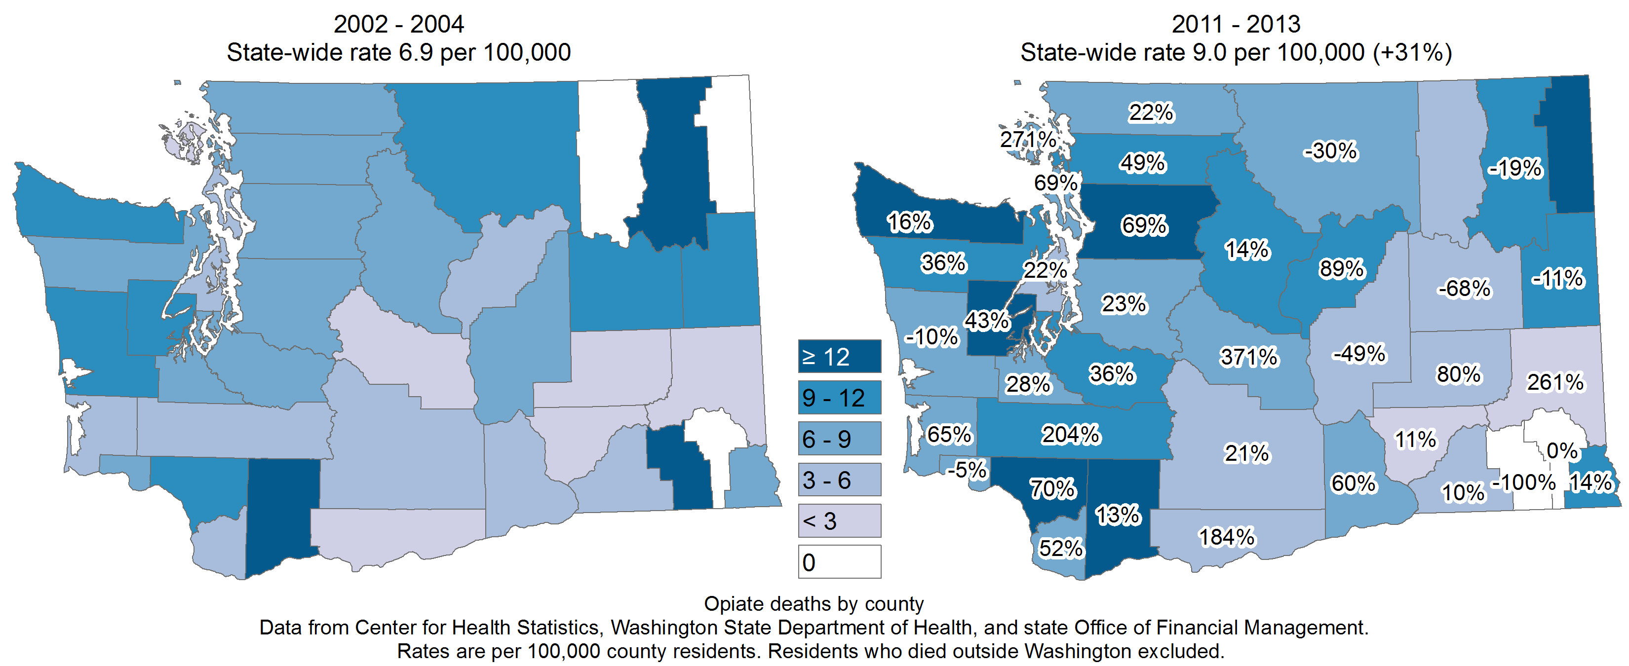
Death Rates Due to Opioids
Notes:
Increase in overdose rates also parallels admissions to treatment and crime lab data where any opiates are discovered.
Increases over 10 years in:
Crime lab data
Deaths
Seeking treatment for opioid use disorders
Particularly in rural areas
Lack of Treatment:
High emergency room utilization
Emergency responders – ambulance, police
Criminal justice expenses – prosecution, jail
Death

Slide 6
Medicaid Expansion and OTPs in Washington State

Slide 7
Context
ACA enacted March 2010
Washington was one of five states that utilized a provision in the ACA that allowed for early expansion of Medicaid, prior to 2014.
As of 2011, Washington was using a waiver from CMS to allow for federal funding to cover adults with incomes up to 133 percent of poverty.
Notes:
Waiver allowed Medicaid coverage for adults that would otherwise not get treatment or need treatment provided for using local funds

Slide 8
Medicaid Expansion in Washington
As of 2015, >525,000 gained Medicaid or CHIP coverage.
Treatment for substance use disorders, including Opioid Treatment Program services became an essential benefit.
  Provided access to MAT for an estimated 40,000 in need in 2010
ACA provided needed funding for OTP services

Slide 9
How Did Added Medicaid Coverage Help?
Increased coverage meant more treatment slots
  Demand was suppressed when treatment was unavailable
  Wait lists exceeded one year
  Potential patients gave up trying to get in
  Patients travelled hours per day to receive daily medication
  Many paid out of pocket when they couldn’t afford to
Initiated collaboration between state & local officials
  How to meet the clinical need?
  Meeting the demand will reduce societal costs
Notes:
Knew the system was failing to address the need, was too slow, was absent where needed.

Slide 10
Discussions at State Level – Expand Treatment?
DSHS Division of Behavioral Health and Recovery
State Opioid Treatment Authority
Notes:
DBHR houses SOTA
Supporter of OTP services
Began engaging with communities asking for OTP services
Found ways to allocate funds
Because funding had been so short, OTPs were suffering

Slide 11
Washington State Medicaid Expansion: DBHR
DSHS Division of Behavioral Health and Recovery:
  Houses the State Opioid Treatment Authority (SOTA)
  Is our accreditation body
  Has conducted multiple cost-benefit and cost-effectiveness studies on SUD
  2004 state analysis of Medicaid payment for OTP services vs those untreated:
  Cost offset of $765 pp/per month
    80% in medical costs
    >1 year of treatment = greatest cost offset
    Longer stays = reduced criminal re-arrest and conviction
    Reference: https://www.dshs.wa.gov/sites/default/files/SESA/rda/documents/research-4-49.pdf
Notes:
DBHR is our accreditation body.
SOTA is extremely supportive of OTPs. Advocates on behalf of industry. Works closely with HCA.
DBHR has history of objectively examining services through alliance with UW and with state Research and Data Analysis
Both HCA and DBHR clearly understood that more OTP services would REDUCE COSTS.

Slide 12
How DBHR Helped OTPs with Medicaid Expansion
DBHR began supporting county requests for OTPs
Find ways to reallocate funds to support OTPs
  Transportation dollars – Medicaid transport reallocated to treatment delivery
Supported 2 bundled rate increases in 2015
Badly needed infrastructure investments
  Capital, administrative
Salary improvements
  Many staff had not seen salary increase in more than 4 years
  We were losing good staff
Notes:
Because money became available with Medicaid expansion, DBHR began engaging with counties who were seeking OTP services.
Administrative: having a strong financial department to work with diverse revenue streams

Slide 13
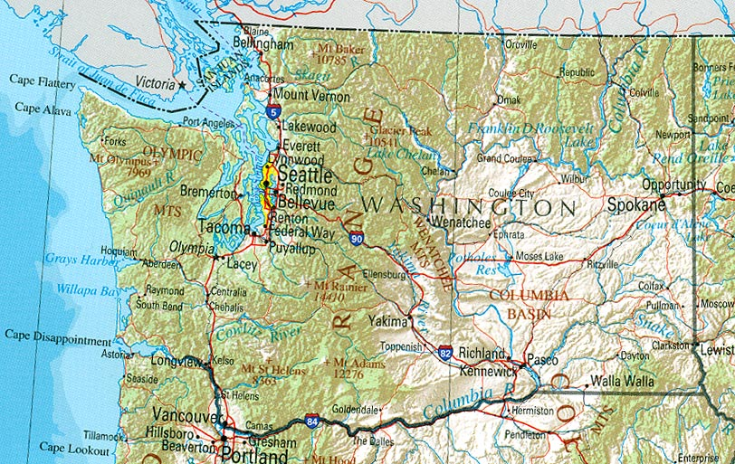
Example: ETS Grays Harbor Clinic - 2014
Notes:
Because of economic base, GH county needed state dollars to be allocated in order to appropriately fund Medicaid services to treat OUDs.
Business model needed to be built primarily on Medicaid reimbursements because this was the primary population.
ETS worked with public health director to educate county officials on

Slide 14
Example: ETS Grays Harbor Clinic
Hoquiam, Washington
Rural (pop 71,000, 2200 sq miles,)
Declining timber, fishing industries
  8.8% unemployment
Some of state’s worst health indicators
One of highest opioid overdose death rates in state
Syringe exchange utilization:
  # needles exchanged is on par with King County (Seattle)
Only treatment = local hospital which restricted Medicaid admissions due to low reimbursement
Notes:
Hospital restricting Medicaid admissions – these were the people in need.
Meant no treatment options.

Slide 15
Example: ETS Grays Harbor Clinic
Currently serving n=350 patients
Reduced annual Medicaid transportation costs by several millions of dollars
  More $ was spent on transporting 50 patients to out-of-county OTPs than on the entire clinic’s needed treatment budget.
Reduced crime
Employment, family health, primary care improvements
Notes:
Skeptical county commissioners at outset
1 year later we have very positive relations with the community
Some dealers have left the area due to decreased profit
Money is being saved by funding our clinic.
Patients who had been paying out of pocket for their treatment are able to pay their rent.
Police chief has become one of our advocates because we make their job easier
Nearby businesses have been responded to

Slide 16
DBHR: More OTPs Open
Between 2013 and 2016, 3 more OTPs opened in the state
  Includes 2 by ETS
In 2015, state legislature and DBHR approved 2 Medicaid bundled rate increases for OTPs totaling $2.16 pp/day.
  Long overdue salary increases
  Infrastructure investment: administrative and physical plant
Notes:
Needed to expand access to care

Slide 17
DBHR: Expanding Access to Care
All counties with ETS clinics raised patient census cap
  ETS patient census increased by n=1000
Expanded dispensary hours
Specialized programming for targeted patient groups:
  Needing more intensive programming to stabilize
  Accommodating a broader range of work hours
  Specialized buprenorphine dispensing hours
Notes:
DBHR help with Medicaid expansion helped immensely.
State regulations limit 350/dispensary
Currently permitted to serve 650 or 700 patients/dispensary at each location
Expanded dispensary hours
Programming to target specific patients (especially those still using who may need more intensive treatment to help stabilize rather than getting discharged due to ongoing drug use)

Slide 18
State Medicaid Expansion: Health Care Authority
State Health Care Authority:
  2013: new Chief Medical Officer and Deputy Chief Medical Officer
    Suboxone prescriber
    Understands cost-effectiveness of expanded treatment
Lifted lifetime Medicaid restriction on bup prescriptions
Clarified state rules so OTPs can dispense bup
Required MCOs to contract with OTPs on dispensed bup
Facilitated OTPs dispending naloxone kits
Notes:
In addition to DBHR’s help, the HCA had changes in leadership in 2013 > changes in policies that facilitated better clinical care
Began partnering with DBHR to strengthen the primary care infrastructure surround OTPs
All of this has helped us as a business serving Medicaid patients.
Has narrowed the difference in service and facilities between nonprofit and for-profit OTPs

Slide 19
Combined DBHR and HCA Partnership Strength
Providing OTP guidance and support on:
  3rd party insurance contracting
  OTPs becoming Medical Homes
  OTPs developing Office Based Opioid Treatment programs (prescriptions for Suboxone)
  Use of telehealth
9 WA OTPs with SAMHSA exceptions for ARNPs and PA-Cs to write medical orders
  Helped to control costs

Slide 20
Result of all this from a business perspective?
Patients are better served
ETS is a much stronger business
  Revenue streams have diversified
  Infrastructure has been strengthened
  Salaries are in line with other nonprofits
Future options available to ETS:
  More contracts with 3rd party insurance
  Bup dispensing as a separate program
  Medical Home
  More infrastructure (capital assets, administrative)
  Continued diversification of programs
Notes:
In addition to more OTPs in state and more patients being served with needed services,
OTPs are doing better as a business and therefore can provide better care

Slide 21
Alignment of Federal, State, Local Priorities
Medicaid Expansion has helped OTPs to meaningfully contribute to addressing opioid epidemic
  More points of service
  More patients being served
  Expand clinical programs for targeted populations
Has fostered key partnerships for system improvement
  HCA and DBHR alignment has strengthened OTPs
  Has helped Washington state engage in interdisciplinary discussions about community solutions
Notes:
WA state is starting to see a levelling off of OD rates – we are hoping this is the first indicator that expansion to treatment and a more coordinated community response is helping to stem the tide.

Slide 22
Secondary Gains from Alignment
State Opioid Task Force
  Prevention, medical disposal, prescribing practices
King County (Seattle):
  Funding/loan assistance to open new OTP
  County/city heroin task force
    Eliminate OTP census cap
    Provide low barrier bup prescriptions
    Encourage MDs to become waivered and prescribe bup
Rural Counties:
  Obtaining service providers where none existed (esp. using telehealth)

Slide 23
Medicaid Expansion Has Helped Washington State Respond to the Opioid Epidemic
Notes:
Expanded patient access to care
Strengthened OTPs as a business
Enabled us to build better treatment interventions

