Slide 1
Justice Community Opioid Innovation Network (JCOIN)
Jessica Hulsey
Addiction Policy Forum
https://jcoinctc.org

Slide 2
JCOIN and the NIH HEAL InitiativeSM
HEAL = Helping to End Addiction Long-term – an aggressive, trans-agency effort to speed scientific solutions to stem the national opioid public health crisis
The NIH HEAL Initiative will bolster research across NIH to improve treatments for opioid misuse and addiction, and enhance pain management
Research spans the entire continuum from prevention research, basic and translational research, clinical trials, to implementation science
In FY2019, NIH obligated >$945M & issues >375 awards
These project include a collection of awards forming NIDA’s Justice Community Opioid Innovation Network (JCOIN)
Notes:
JCOIN is part of the HEAL Initiative, that is Helping to End Addiction Long-term Initiative
It is an NIH-wide initiative that cuts across the entire agency that focuses on spreading scientific solutions to stem the national opioid public health crisis
Meant to bolster research across NIH
It is part of a very large appropriation that Congress made to NIH
In FY19 NIH received over $945 million and made over 375 awards
JCOIN is one of those projects and covers over 15 of those awards

Slide 3
JCOIN Vision & Priority Goals
Vision
Every individual involved in the justice system with a substance use disorder should have timely access to effective treatment, while detained and while in the community.
Priority Goals
Generate new evidence about what works and how to effectively implement
Become a go-to resource for researchers and practitioners
Develop a network of researchers collaborating with practitioners across justice and community-based service settings.
Build capacity to conduct and apply research in justice settings
Speed translation of science to solutions and create feedback loops.
Notes:
The vision of JCOIN is that “Every individual involved in the justice system with a substance use disorder should have timely access to effective treatment, while detained and while in the community.”
JCOIN 5 priority goals:
Generate new evidence about what works and how to effectively implement
Hope to become a go-to resource for researchers and practitioners
To do that we hope to Develop a network of researchers collaborating with practitioners across justice and community-based service settings.
Build capacity to conduct and apply research in justice settings – focused on researchers and practitioner
And ultimately what that we’ll see Speed translation of science to solutions and create feedback loops -- there is an often research that it takes 17 for something that is found in a scientific to make it into practice. JCOIN would like to shorten that timely.
At the heart of JCOIN there are 13 clinical trials

Slide 4
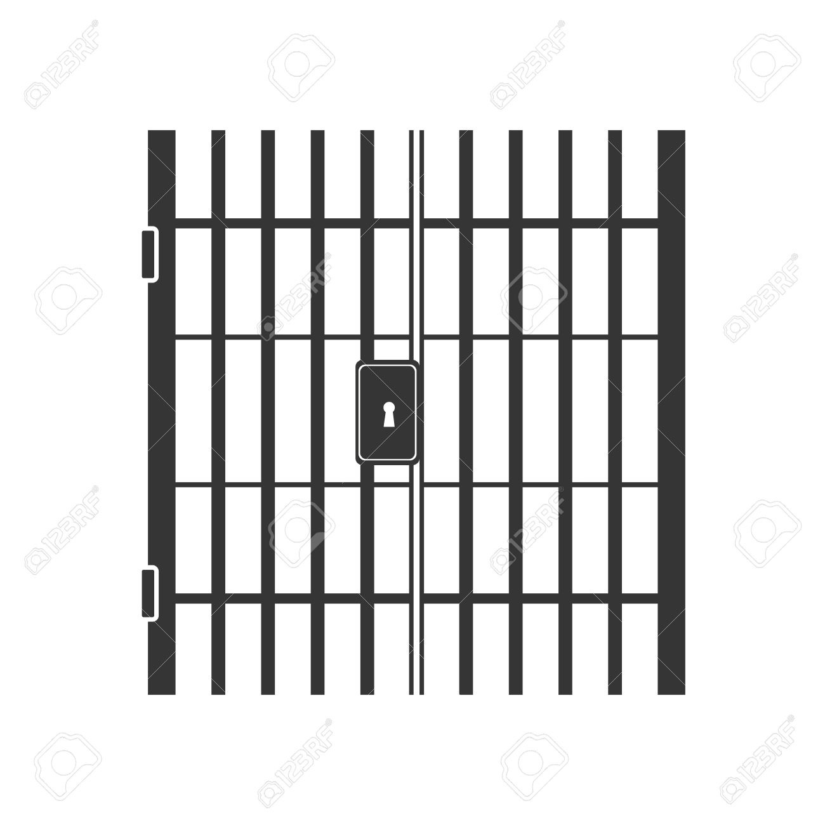
Justice System Responses to the Opioid Crisis Missed Opportunities to Improve Public Health & Public Safety
>10M arrested & 2M incarcerated annually
17-19% of inmates have used opioids; < 1% receive MOUD
<5% of jails offer MOUD to inmates
Treatment in Jails & Prisons
129x risk of dying of a drug overdose during re-entry
MOUD during incarceration cuts mortality by up to 75%
Re-Entry
95% return to community; 4.7M on probation or parole
Justice-referred patients are ~1/10 as likely to receive MOUD
Many drug courts or probation officers prohibit MOUD
Community-Based Treatment

Slide 5
JCOIN Priority Goals & Components
Training &
Outreach
Stakeholder
Engagement
Research
Dissemination
Clinical Trials (13)
Surveys (11)
Implementation Studies
Policy Research
Modeling Studies (9)
Rapid Innovation Grants (up to 4/year)
Cross-cutting Protocols & Research Questions
Common Measures
Communication & Information Dissemination
Outreach to Agencies and Funders
Data commons
Researcher Training
Practitioner Training
Technical Assistance & Outreach to the Field
Online Training Resources (J-TEC)
Steering Committee
Practitioner Board
Outreach to Stakeholder Communities
Generate New Evidence
Become a Go to Resource
Build Capacity
Speed Science to Solutions
Crosscutting Foundation: Collaborative Network of Researchers and Practitioners

Slide 6
Justice Community Opioid Innovation Network (JCOIN) Structure
Federal Stakeholder Workgroup
NIDA
JCOIN Director, Program Officers, Science Officer
NIH/NIDA Oversight Committees
External Practitioner & Stakeholder Board(s)
Steering Committee
Nickolas Zaller, Chair
Workgroups
Administrative Core
Administrative Core
Coordination and Translation Center
Methodology and Advanced Analytics Resource Center
Dissemination and Stakeholder Engagement
Research Hubs
Data and Analytics Support
Research Education
Policy & Practice Observational and Survey Research
Implementation and Translation Research Project
Communities =
Justice + Behavioral Health Organizations
Rapid Response & Pilot Research
Advanced Methodological Research
Multisite Studies: > 5 communities per Hub
Community Stakeholder Resource*
Research projects
*With support from the Bureau of Justice Assistance

Slide 7
Coordination and Translation Center
Coordination and Translation Center
Capacity Building
Dissemination +Stakeholder Engagement
Administrative
Implementation +Translational Research
Rapid Response and Pilot Research
Community Stakeholder Resources

Slide 8
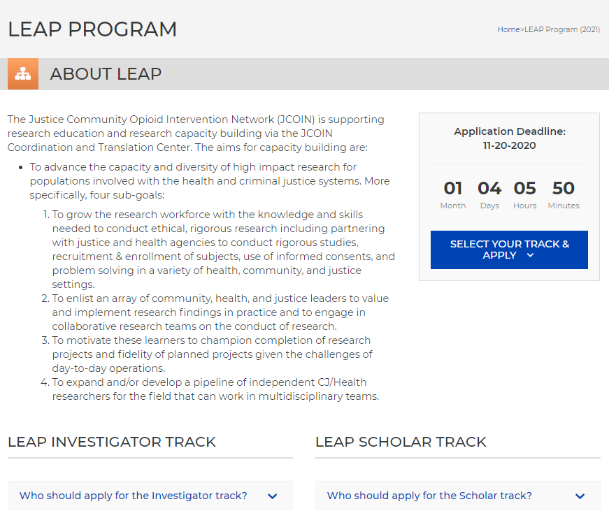
Build Capacity: Learning Experiences to Advance Practice (LEAP)
Scholar Track (1 year)
Investigator Track (2 years)
Multidisciplinary Training Cohort
Now Recruiting!
Direct Questions to Warren Ferguson (Warren.Ferguson@umassmemorial.org)

Slide 9
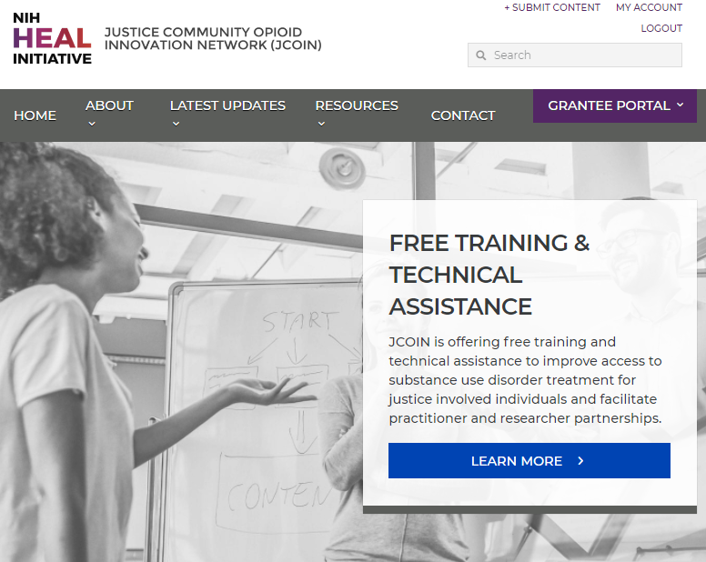
Build Capacity: On-Demand Technical Assistance
Tailored support and resources to assist with research and evaluation efforts at the state & local levels
Support can be offered to:
State and local justice agencies
Behavioral health agencies
Researchers working in partnership with local agencies
Direct Questions to tta@jcoinctc.org.
Funding for this effort provided by the Bureau of Justice Assistance.

Slide 10
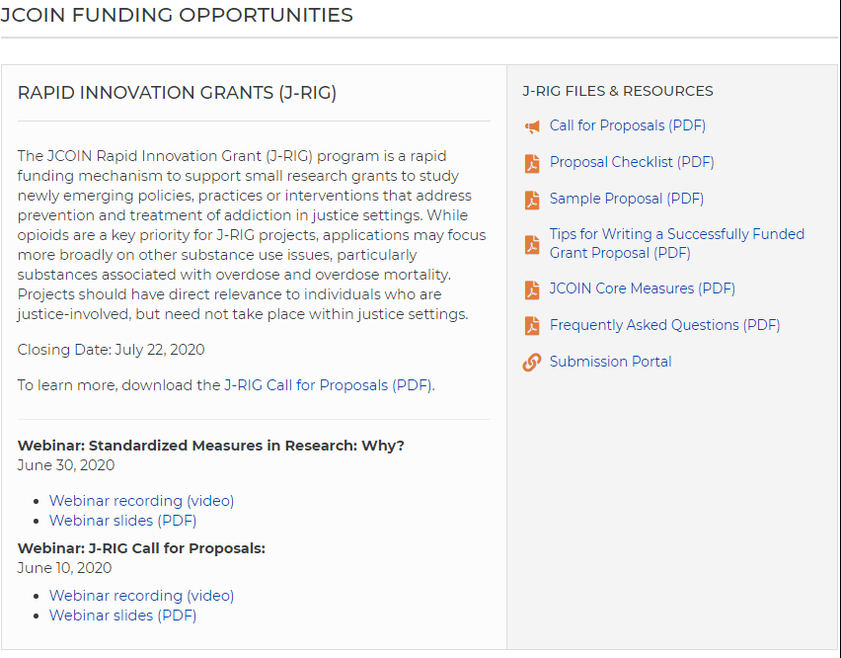
Research: JCOIN Rapid Innovation Grants (J-RIG)
Small Grant Program Supported Through JCOIN Coordination Center
Technical Assistance Available Online Including:
Common Measures
Sample Proposal
Tips for Writing
Webinar from Previous Call
Reviewed by JCOIN Researchers & Partners
Direct Questions to Rebekah Hersch (jcpilot@gmu.edu)

Slide 11
Meaningful Engagement of Stakeholders
Engagement and network building for 26 distinct audiences
Jails
Corrections
Community Corrections
Law Enforcement
Juvenile Justice
Judicial/Drug Courts
Juvenile & Family Courts
Prosecutors/Defenders
Anti-Drug/
Community Coalitions
Health Associations/
Professionals Organizations
Impacted
Individuals
State and Local Government
Peer Based Services/Impacted
Treatment Providers
Family & Children Services
Public Health Departments/Fire/EMS
Recovery Support Services
Healthcare/Addiction Medicine
Reform Advocates
JCOIN
Private Foundations
Health Systems
Acute Care/Emergency
Community Services
Journalists/Media
Children Impacted by Parental Substance Use Disorder
Justice System
Individuals in Recovery from Substance Use Disorder
State and Local Governments
Justice-involved Individuals
Coordinating Entities
Impacted Families

Slide 12
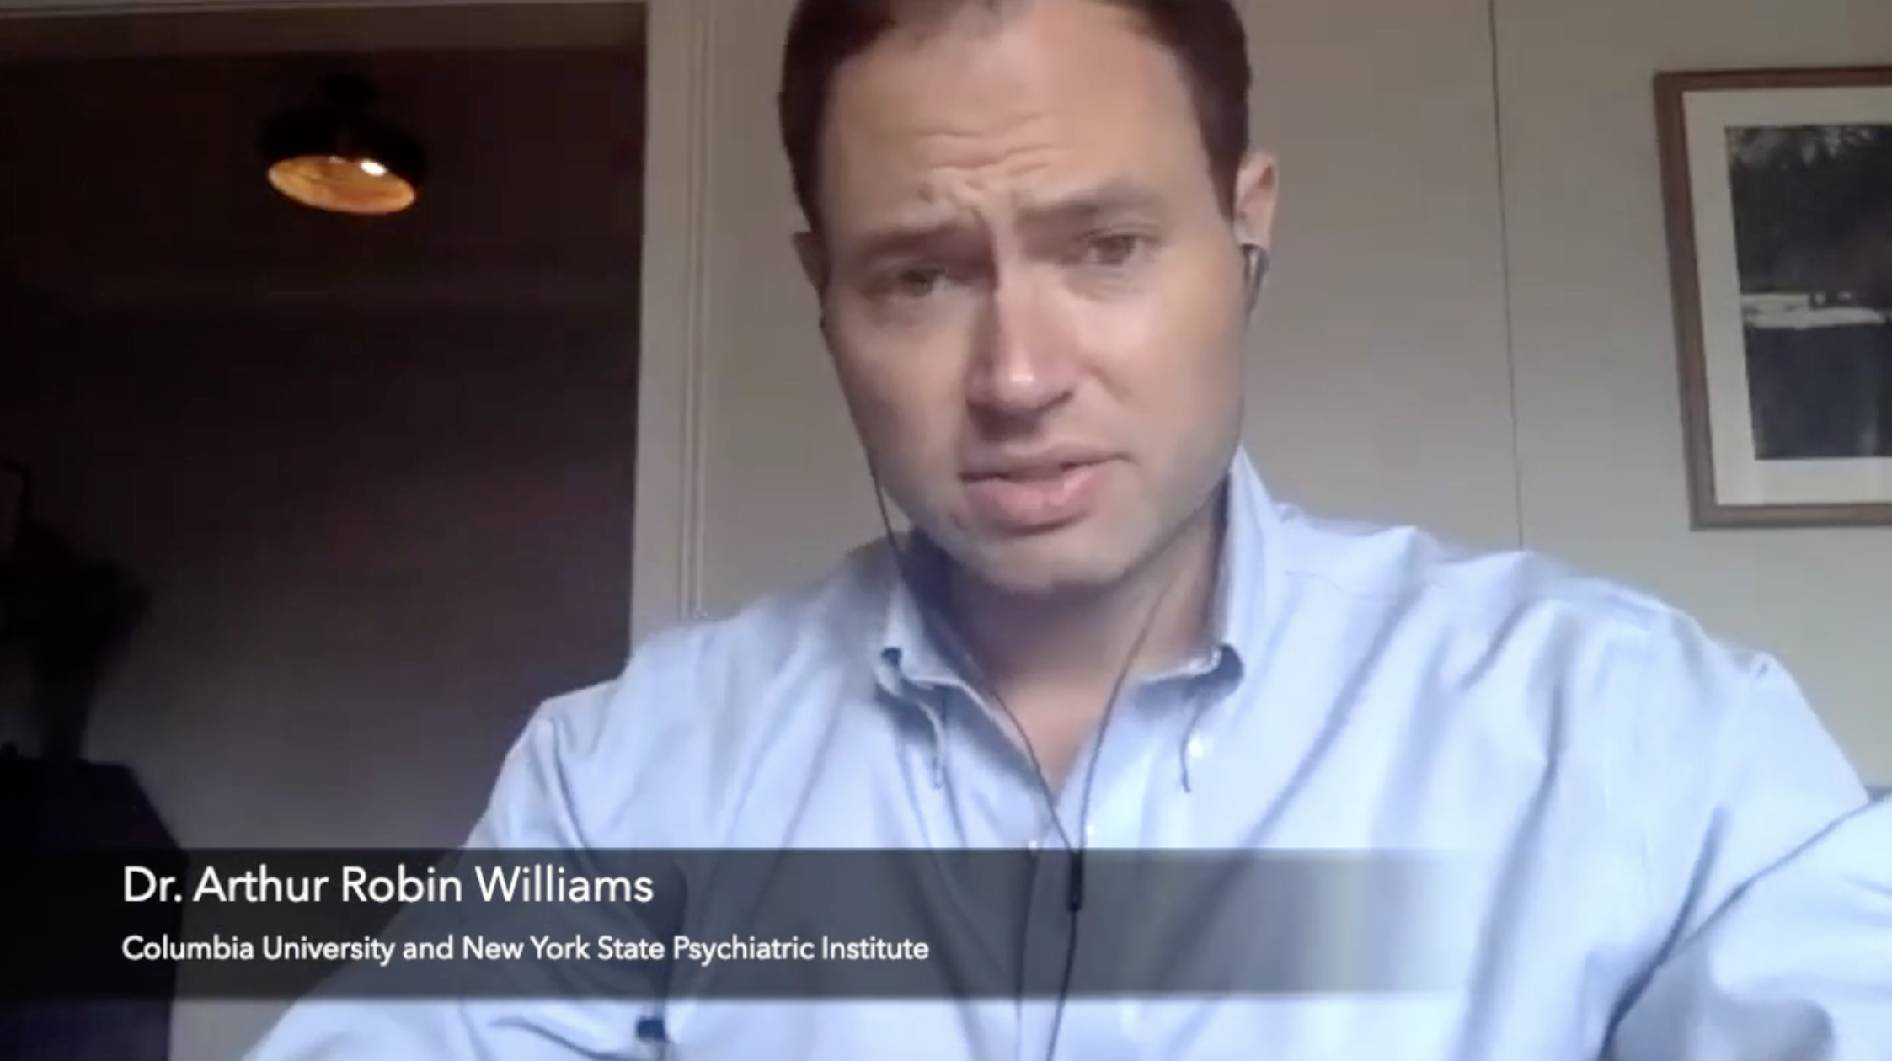
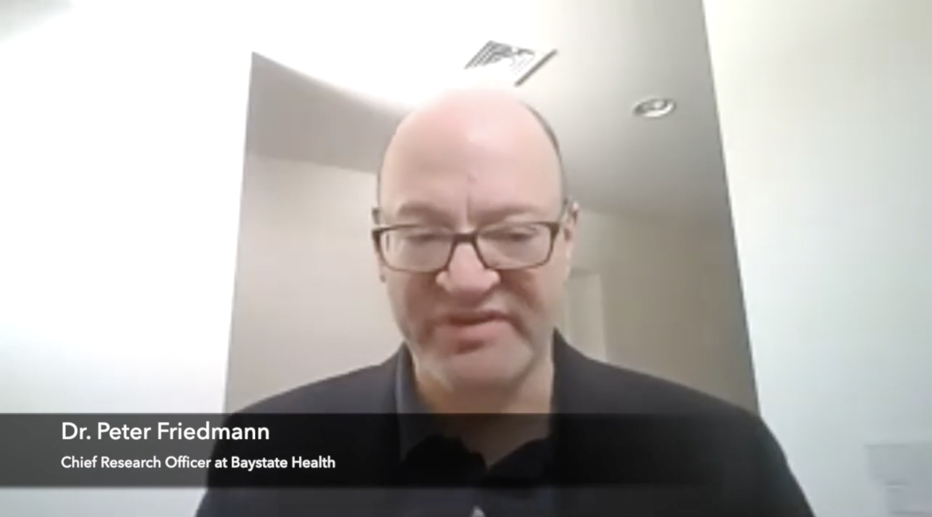
eCourses for Practitioners
Implementing MAT in Correctional Settings
Applications of MOUD for Courts
Reentry Research Applications
Medications for Opioid Use Disorder: Lessons for State Leaders

Slide 13
Thank you!
Questions about JCOIN
Jessica Hulsey
jhulsey@addictionpolicy.org
jcoinctc.org

